Slide 1
Apache 2 Web Sever
Administration

Slide 2
Apache 2 Administration
Goals
Introduction to Apache
Installing Apache
Managing Apache
Modules & directives
Configuring Apache
Security
Secure sockets layer (ssl) security

Slide 3
Apache 2 Administration
Goals
Logs
Dynamic web content
Virtual hosts, redirection and indexing
Redirection methods
Enhance or limit functionality using modules
Directory indexing
Proxy servers and firewalls

Slide 4
Apache 2 Administration
Goals
Monitoring apache web server
Content Caching
URL Mapping
Apache web server status & server information
Performance Tuning
Improving performance

Slide 5
Apache 2 Administration
Goals
• Apache virtual host workflow and configuration in detail
• Apache MPM configurations and usages
• Server capacity (like RAM, ROM) needed for n number of users (say n=3000+).
• Apache tuning when there is high server load
• Other Apache mechanism for handling uncertain situations

Slide 6


Slide 7
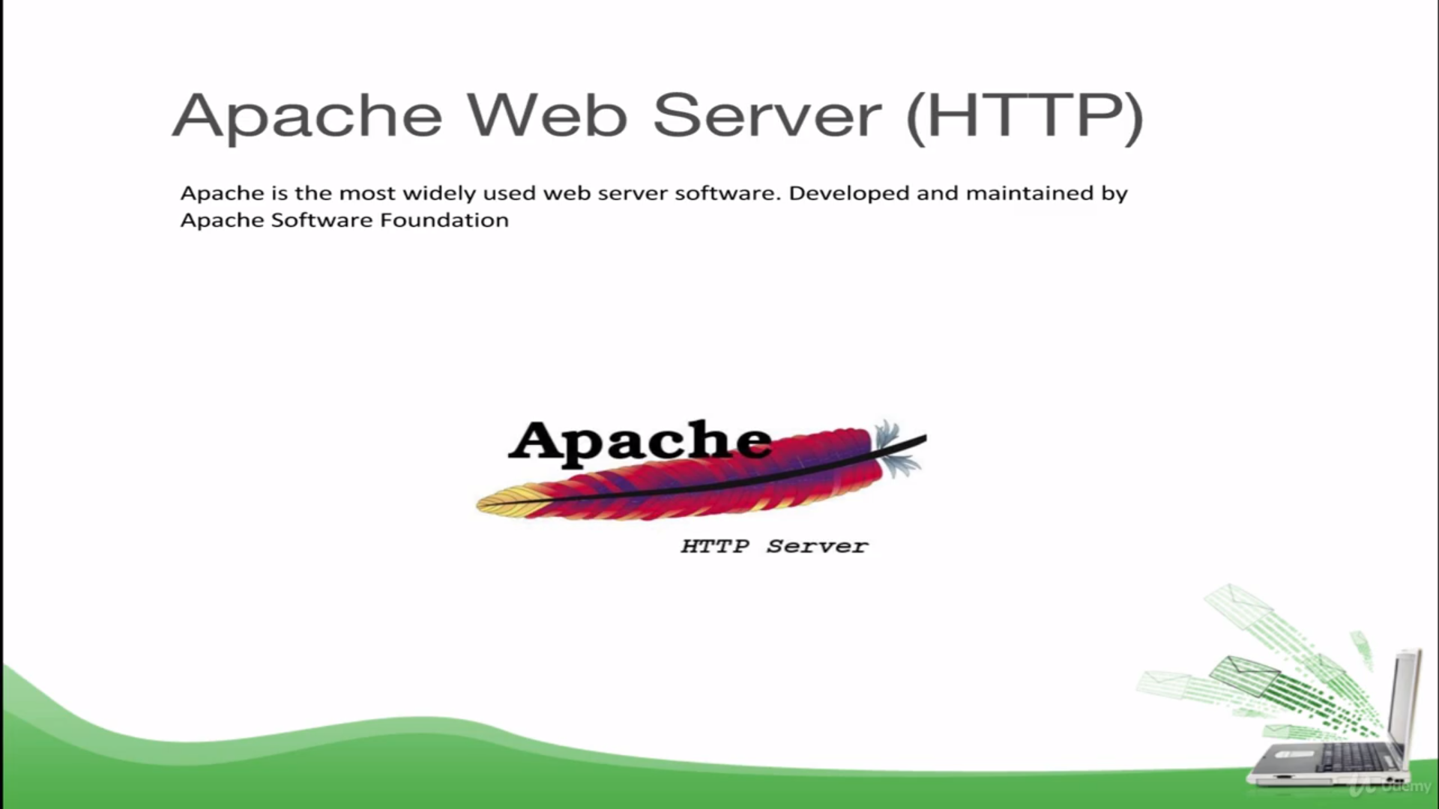

Slide 8
Introduction To Apache 2
In the July 2020 survey Netcraft survey received responses from 1,234,228,567 sites across 260,658,118 unique domains and 10,221,919 web-facing computers.
This represents a gain of 9.47 million sites and 180,000 computers, but a loss of 1.75 million domains.
July 2020 most of the major server vendors saw gains in total sites this month: Apache gained 9.8 million sites.
While Microsoft and nginx gained 5.4 million and 2.5 million sites respectively.
LiteSpeed continued to see strong growth, gaining 1.95 million new sites this month.

Slide 9
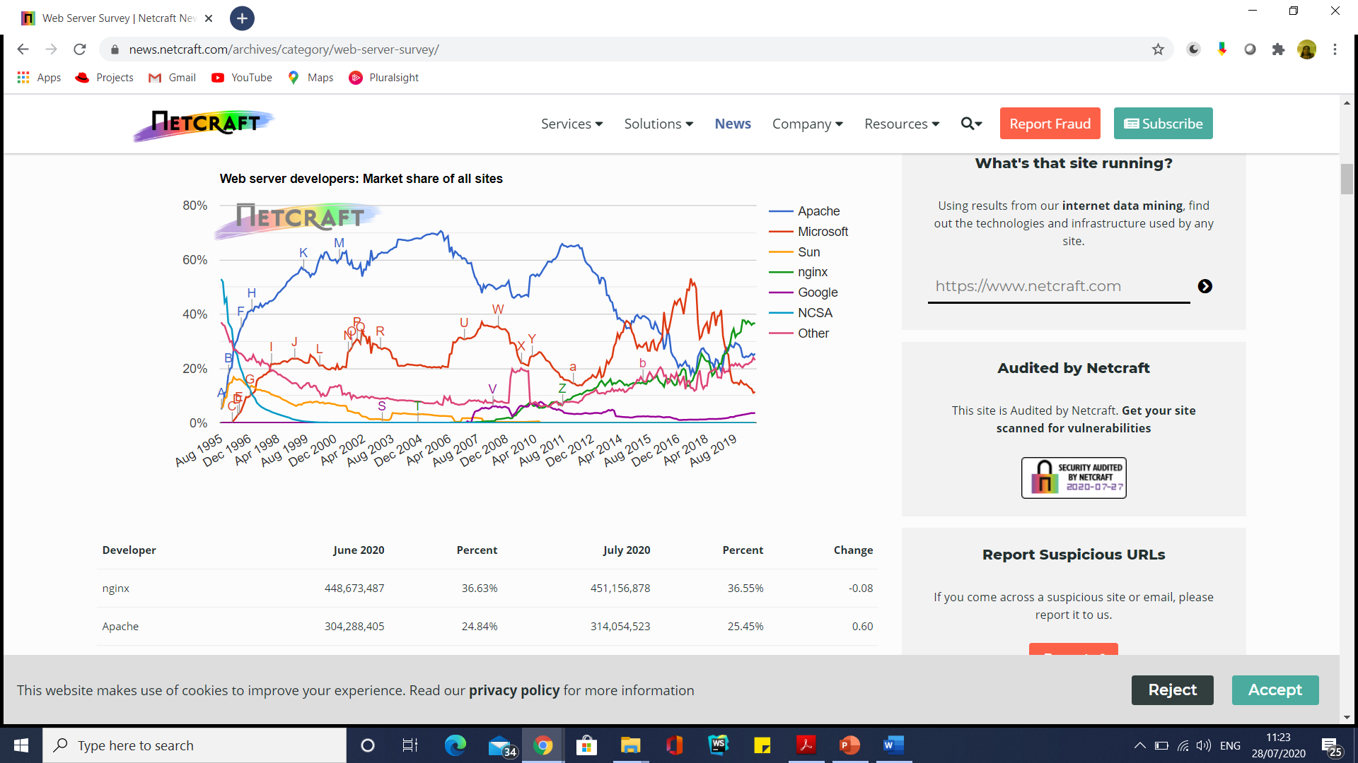
Introduction To Apache 2
Developer | June 2020 | Percent | July 2020 | Percent | Change
nginx | 448,673,487 | 36.63% | 451,156,878 | 36.55% | -0.08
Apache | 304,288,405 | 24.84% | 314,054,523 | 25.45% | 0.60
Microsoft | 134,874,928 | 11.01% | 140,264,332 | 11.36% | 0.35
Google | 43,449,240 | 3.55% | 44,290,430 | 3.59% | 0.04

Slide 10
Who is using Apache Web Server?
Popular Companies Using Apache HTTP Server:
IBM
eBay
Adobe
PayPal
Linkedin
GTMetrix
Facebook
Aspire

Slide 11
Alternative to Apache HTTP Server
Nginx
Apache Tomcat
Node.js
Lighttpd
Cherokee
Microsoft IIS
Appweb
Hiawatha

Slide 12
Apache Rocks On
Apache is a highly configurable Web Server with a modular design.
It is very easy to extend the capabilities of Apache Web server. Anyone with decent C or Perl programming expertise can write a module to perform a special function. This means that there are tons of Apache modules available for use.
Apache is a free, open source technology.
Apache works great with Perl, PHP, and other scripting languages.

Slide 13
Apache Rocks On
Apache runs on Linux and other Unix systems.
Apache also runs on Windows.
Installing Apache
To install Apache, install the latest meta-package apache2 by running:
sudo apt update
sudo apt install apache2
Adjusting Firewall
sudo ufw app list
sudo ufw allow 'apache'

Slide 14
Apache Rocks On
Apache runs on Linux and other Unix systems.
Apache also runs on Windows.
Installing Apache
To install Apache, install the latest meta-package apache2 by running:
sudo apt update
sudo apt install apache2
Adjusting Firewall
sudo ufw app list
sudo ufw allow 'apache'

Slide 15
Apache Rocks On
sudo ufw status
sudo service apache2 start
sudo service --status-all
sudo vi /etc/apache2/ports.conf //to change port number
#to suppress warning when we start server
#add this in ports.conf
AcceptFilter https none
AcceptFilter http none

Slide 16
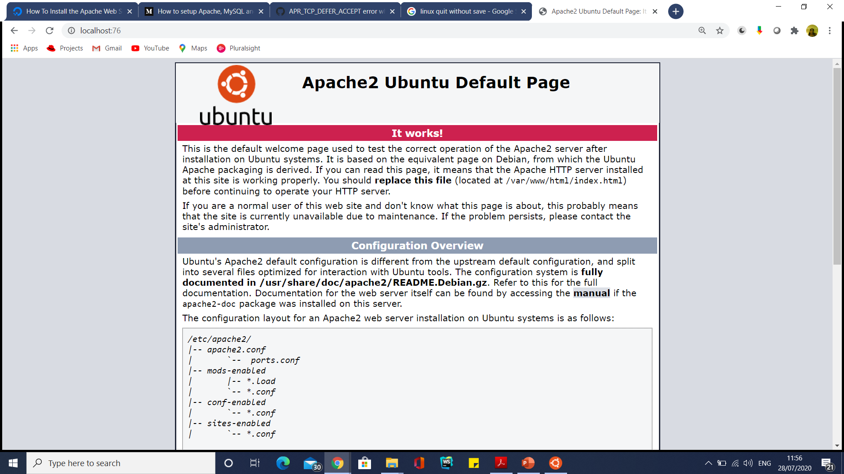

Slide 17
Apache: The Beginning
In the early days of the Web, the National Center for Super Computing Applications (NCSA) created a Web server that became the number one Web server in early 1995.
However, the primary developer of the NCSA Web server left NCSA about the same time, and the server project began to stall.
In the meantime, people who were using the NCSA Web server began to exchange their own patches for the server and soon realized that a forum to manage the patches was necessary.
The Apache Group was born. The group used the NCSA Web server code and gave birth to a new Web server called Apache.

Slide 18
Apache: The Beginning
Originally derived from the core code of the NCSA Web server and a bunch of patches, the Apache server is now the talk of the Web server community.
In three short years, it acquired the lead server role in the market.

Slide 19
Apache: The Beginning
The very first version (0.6.2) of publicly distributed Apache was released in April 1995.
The 1.0 version was released on December 1, 1995.
The Apache Group has expanded and incorporated as a nonprofit group.
The group operates entirely via the Internet.
However, the development of the Apache server is not limited in any way by the group.
Anyone who has the know-how to participate in the development of the server or its component modules is welcome to do so, although the group is the final authority on what gets included in the standard distribution of what is known as the Apache Web server.

Slide 20
Apache: The Beginning
This allows literally thousands of developers around the world to come up with new features, bug fixes, ports to new platforms, and more.
When new code is submitted to the Apache Group, the group members investigate the details, perform tests, and do quality control checks. If they are satisfied, the code is integrated into the main Apache distribution.

Slide 21
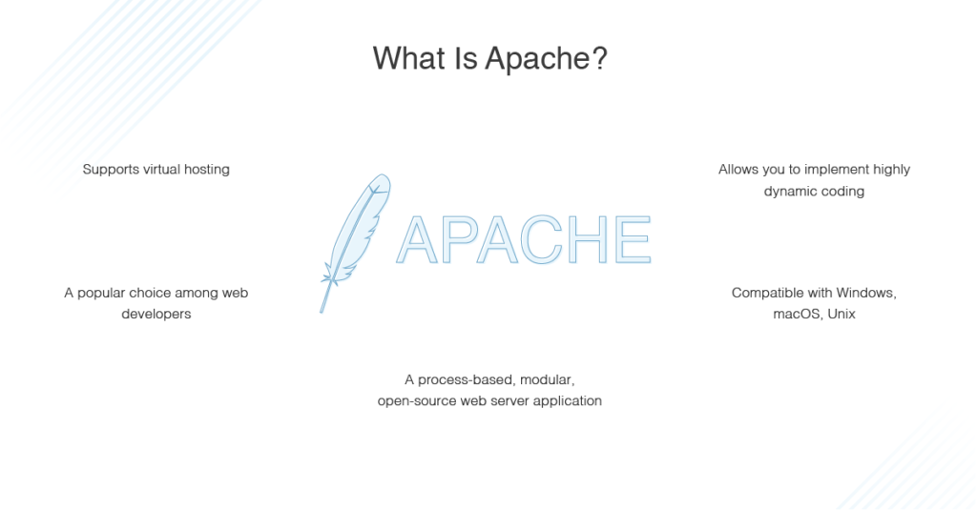

Slide 22
Apache vs IIS
Feature | IIS | Apache
Supported OS | Windows | Linux, Unix, Windows, Mac OS
User support & fixes | Corporate support | Community Support
Cost | Free, but bundled with Windows | Completely free
Development | Closed, proprietary | Open source
Security | Excellent | Good
Performance | Good | Good
Market Share | 32% | 42%

Slide 23
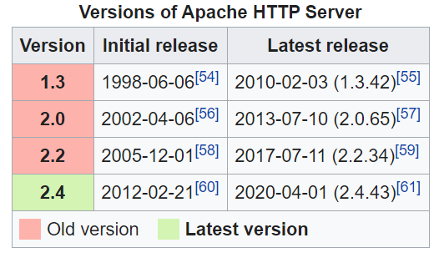
Current Apache Versions

Slide 24
The Apache Feature List
One of the greatest features that Apache offers is that it runs on virtually all widely used computer platforms.
At the beginning, Apache used to be primarily a Unix based Web server, but that is no longer true.
Apache not only runs on most flavors of Unix, but it also runs on Windows 2000/NT/9x and many other desktop and server-class operating systems such as Amiga OS 3.x and OS/2.
Apache HTTP Server versions later than 2.2 will not run on any operating system earlier than Windows 2000.

Slide 25
The Apache Feature List
Apache offers many other features including
fancy directory indexing
directory aliasing
content negotiations
configurable HTTP error reporting
SetUID execution of CGI Programs
resource management for child processes
server-side image maps
URL rewriting
URL spell checking
online manuals.

Slide 26
The Apache Feature List
Apache offers many other features including
Simple, yet powerful file-based configuration
Support for CGI (Common Gateway Interface)(mod_cgi)
Support for FastCGI(mod_fcgi)
Support for virtual hosts
Support for HTTP authentication
Integrated Perl(mod_perl)
Support for PHP scripting(mod_php)
Java Servlet support(jsp)

Slide 27
The Apache Feature List
Apache offers many other features including
Handling of static files
Loadable dynamic modules
Auto-indexing
.htaccess
Compatible with IPv6
Supports HTTP/2
FTP connections
Gzip compression and decompression
Bandwidth throttling
Perl, PHP, Lua scripts
Load balancing
Session tracking
Geolocation based on IP address

Slide 28
The Apache Feature List
Apache offers many other features including
Integrated Proxy server
Server status and customizable logs
Support for Server-Side Includes (SSI)
Support for Secured Socket Layer (SSL)(mod_ssl)

Slide 29
Fancy Indexing
Fancy indexing shows the files plus additional information about them like the date the file is last modified, their size and description.
To use that type of indexing, add the following two lines in a file named .htaccess in the destination folder:
Options +Indexes
IndexOptions +FancyIndexing

Slide 30
Directory Alias
Directory alias are used to map between URLS entered in the browser to filesystem paths.
Creating an alias on the installation server enables the URL: http://servername/oss114 to map to the directory located at /install/11-4 and solving my problem.

Slide 31
Content Negotiation
Content negotiation is the ability of a web server to deliver the document that best matches the browser's preferences/capabilities.
For example, if a resource exists in multiple languages, the web server can choose which variant it serves based on the Accept-Language header delivered by the browser.

Slide 32
SetUID execution of CGI Programs;
CGI root access should have SetUID

Slide 33
Virtual Host
An Apache web server can host multiple websites on the SAME server.
You do not need separate server machine and apache software for each website.
This can be achieved using the concept of Virtual Host or VHost.
Any domain that you want to host on your web server will have a separate entry in apache configuration file.

Slide 34
Apache 2 Architecture

Slide 35
Apache 2.4 Architecture
Multiprocessing modules
The first major change in Apache 2.0 is the introduction of multiprocessing modules (MPMs).
To understand why MPMs are created, you need to understand how Apache worked before.
Apache Version 1.3 or earlier used a preforking architecture.
In this architecture, an Apache parent process forked a set of child processes, which serviced the actual requests.
The parent process simply monitored the children and spawned or killed child processes based on the amount of requests received.
Unfortunately, this model didn’t work well under platforms that are not process-centric such as Windows.
So, the Apache Group came up with the MPMbased solution.

Slide 36
Apache 2.4 Architecture
Each MPM is responsible for starting the server processes and for servicing requests via child processes or threads depending on the MPM implementation.
Several MPMs are available.

Slide 37
How Apache Works: MPM

Slide 38
Apache 2.4 Architecture
The prefork MPM
The prefork MPM mimics the Apache 1.3 or earlier architecture, creating a pool of child processes to service requests.
Each child process has a single thread.
For example, if Apache starts 30 child processes, it can service 30 requests simultaneously.
If something goes wrong and the child process dies, only a single request is lost.

Slide 39
Apache 2.4 Architecture
The number of child processes is controlled using a minimum and maximum setting.
When the number of requests increases, new child processes are added until the maximum is reached.
Similarly, when the requests fall, any extra child processes are killed.

Slide 40
Apache 2.4 Architecture
The threaded MPM
This MPM enables thread support in Apache 2.0.
This is like the prefork MPM, but instead of each child process having a single thread, each child process is allowed to have a specified number of threads.
Each thread within a child process can service a different request.
If Apache starts 30 child processes where each child is allowed to have at maximum 10 threads, then Apache can service 30 × 10 = 300 requests simultaneously.

Slide 41
Apache 2.4 Architecture
The threaded MPM
If something goes wrong with a thread, for example, an experimental module causes the thread to die, then the entire process dies.
This means that all the requests being serviced by the threads within the child process will be lost.
However, because requests are distributed among threads on separate child processes, it is likely that a child’s death will take down at maximum of 1/n of all the total connection, where n presents the number of all simultaneous connections.

Slide 42
Apache 2.4 Architecture
The threaded MPM
A process is added or removed by monitoring its spare-thread count.
For example, if a process has less than the minimum number of spare threads, a new process is added.
Similarly, when a process has a maximum number of idle threads, it killed.
All processes run under the same user and group ID assigned to Apache server.
Because threads are more resource efficient than processes, this MPM is very scalable.

Slide 43
Apache 2.4 Architecture
The perchild MPM
This is also new in Apache 2.0.
In this MPM model a set number of child processes are started with a specified number of threads.
As request load increases the processes add new threads as needed.
When request count reduces, processes shrink their thread counts using a minimum and maximum thread count setting.
The key difference between this module and the threaded MPM is that the process count is static and also each process can run using a different user and group ID.

Slide 44
Apache 2.4 Architecture
The perchild MPM
This is also new in Apache 2.0.
In this MPM model a set number of child processes are started with a specified number of threads.
As request load increases the processes add new threads as needed.
When request count reduces, processes shrink their thread counts using a minimum and maximum thread count setting.
The key difference between this module and the threaded MPM is that the process count is static and also each process can run using a different user and group ID.
This makes it easy to run different virtual Web sites under different user and group IDs.

Slide 45
Apache 2.4 Architecture
The winnt MPM
This is the MPM for the Windows platform, including Windows 2000, Windows NT, and Window 9x.
It is a multithreaded module.
Using this module Apache will create a parent process and a child process.
The child process creates all the threads that services the request.
Also, this module now takes advantage of some Windows-only native function calls, which allows it to perform better than the earlier versions of Apache server on Windows platform.

Slide 46
Apache 2.4 Architecture
Filtering I/O
Apache 2.0 now provides architecture for layered I/O.
This means that one module’s output can become another module’s input.
This filtering effect is very interesting.
For example, the output produced by CGI scripts, which is processed by the mod_cgi module, can now be handed to the mod_include module responsible for SSIs.
SSI (Server Side Includes) are directives that are placed in HTML pages, and evaluated on the server while the pages are being served.
In other words, CGI scripts can produce output as SSI tags, which can be processed before the final output is sent to the Web browser.

Slide 47
Apache 2.4 Architecture
New CGI daemon
Because many of the MPM modules use threads, executing CGI scripts become cumbersome when a thread gets such a request.
The mod_cgi module still works, but not optimally for threaded MPMs, so mod_cgid was added.
The mod_cgid module creates a daemon process, which spawns CGI processes and interacts with threads more efficiently.
Figure shows how a CGI request for a script called
myscript.pl is serviced.

Slide 48
Apache 2.4 Architecture

Slide 49
Apache 2.4 Architecture
Here is how the CGI scripts are executed:
1. When the CGI request comes to a thread within a child process, it passes the request to the CGI daemon.
2. The CGI daemon spawns the CGI script and outputs the CGI script-generated data to the thread in the child process.
3. The thread returns the data to the Web browser.

Slide 50
Apache 2.4 Architecture
When the main Apache server starts, it also starts the CGI daemon and establishes a socket connection.
So, when a new child process is created, it inherits the socket connection and therefore does not have any need to create a connection to the CGI daemon for each request.
The entire process improves CGI execution in the threaded environment.

Slide 51
Apache 2.4 Architecture
Apache Portable Run-Time
In furtherance of the Apache Group’s vision to create the most popular Web server in the world, it became clear that Apache’s portability needed to be addressed in Apache 2.0.
Prior to the current release, Apache had been dealing with portability internally, which made the code base less manageable.
So, Apache Group introduced the Apache Portable Run-Time (APR). APR’s purpose is to provide a single C interface to platform-specific functions so that code can be written once.
This enables Apache to run more natively on platforms such as Windows, BeOS, Amiga, and OS/2.
Because of APR, many programs, such as ApacheBench, can run on these platforms.

Slide 52
Understanding the Apache License
Free software such as Apache, Perl (Practical Extraction and Reporting Language), and Linux (an x86-based Unix clone operating system) are getting a great deal of press because of Netscape’s decision to make Netscape Communicator, one of the most popular Web browsers, available for free with its Mozilla project.
Unfortunately, free software such as Apache, Perl, and Linux do not share the same licensing agreements, and so the media has created some confusion by associating these packages in the same licensing category.

Slide 53
Understanding the Apache License
All free software is intended to be, well, free for all.
However, there are some legal restrictions that the individual software licenses enforce.
For example, Linux, which is made free by GNU Public License (GPL), requires that any changes to Linux be made public.
Apache, on the other hand, does not require that changes made to Apache be made public by anyone.

Slide 54
Understanding the Apache License
In short, think of Apache as free, copyrighted software published by the Apache Group.
It is neither in the public domain nor is it shareware.
Also note that Apache is not covered by GPL.

Slide 55
How to install & configure Apache on a Windows server
Step 1 - Download Apache for Windows
Step 2 - Unzip
Step 3 - Configure Apache
Step 4 - Start Apache
Step 5 - Check Apache
Step 6 - Install Apache as a Windows service
Step 7 - Monitor Apache (optional)

Slide 56
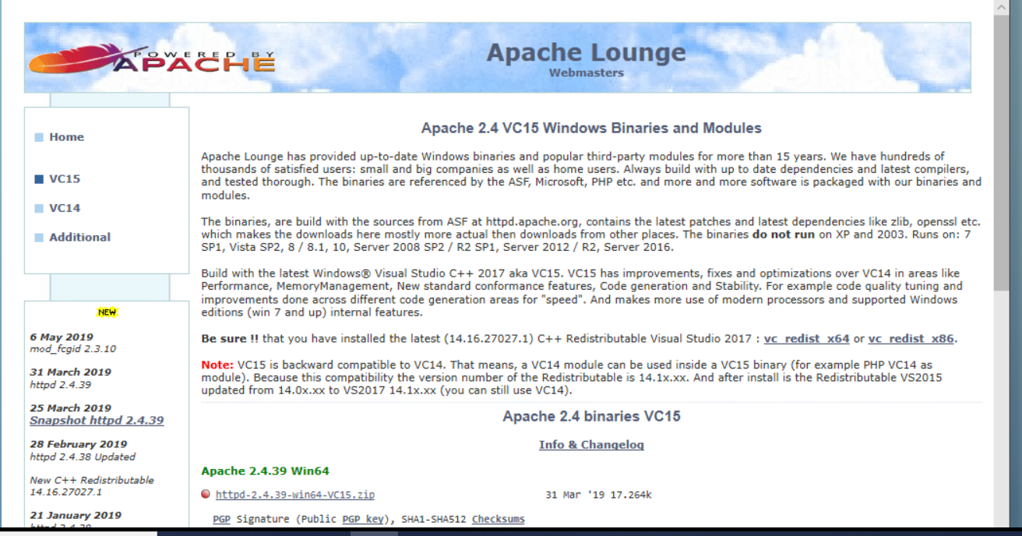
How to install & configure Apache on a Windows server
Step 1 - Download

Slide 57
How to install & configure Apache on a Windows server
Step 2 - Unzip
Once the download has completed, open the downloaded "httpd-2.4.39-win64-VC15.zip" file, and extract its contents to a suitable location on your server i.e. C:\Apache24 or D:\Apache, etc

Slide 58
How to install & configure Apache on a Windows server
Step 3 - Configure Apache
Once you've extracted Apache, configure it.
Start by locating the file "httpd.conf" (which will be in the "conf" sub directory), and open this in a standard text editor.
By default, this configuration file assumes that you've extracted Apache to C:\Apache24.
If however you've extracted Apache to a different location (i.e. D:\Apache), you'll need to update the ${SRVROOT} variable within in the httpd.conf file to point to the new location accordingly, i.e:
Define SRVROOT "C:/Apache24" → Define SRVROOT "D:/Apache"

Slide 59
How to install & configure Apache on a Windows server
Step 3 - Configure Apache
If there is no SRVROOT variable present in your httpd.conf file, then instead we'll need to manually update all instances of "C:/Apache24", i.e.:
ServerRoot "C:/Apache24" → ServerRoot "D:/Apache"
DocumentRoot "C:/Apache24/htdocs" → DocumentRoot "D:/Apache/htdocs"
<Directory "C:/Apache24/htdocs"> → <Directory "D:/Apache/htdocs">
ScriptAlias /cgi-bin/ "C:/Apache24/cgi-bin/" → ScriptAlias /cgi-bin/ "D:/Apache/cgi-bin/"

Slide 60
How to install & configure Apache on a Windows server
Step 3 - Configure Apache
Regardless of where you extracted Apache to, you'll also need to make the following modifications to the http.conf file:
A) Add "ExecCGI" to "Options" directive:
Locate the following line:
Options Indexes FollowSymLinks
...and append "ExecCGI":
Options Indexes FollowSymLinks ExecCGI
...this tells Apache that CGI/Perl scripts are allowed outside of the cgi-bin directory

Slide 61
How to install & configure Apache on a Windows server
Step 3 - Configure Apache
B) Locate and uncomment the following line: (by removing the # symbol from the start of the line)
AddHandler cgi-script .cgi
...and also add the following line:
AddHandler cgi-script .pl
...These two lines tell Apache how to handle .cgi/.pl files (i.e. execute them rather than present them to as text to a web browser)

Slide 62
How to install & configure Apache on a Windows server
Step 3 - Configure Apache
C) Add the following line to the end of the httpd.conf file:
ScriptInterpreterSource Registry
...this allows Apache to ignore the very first line of .cgi/.pl files which direct Apache to the install location of Perl, and instead determine the location of Perl from the Windows Registry

Slide 63
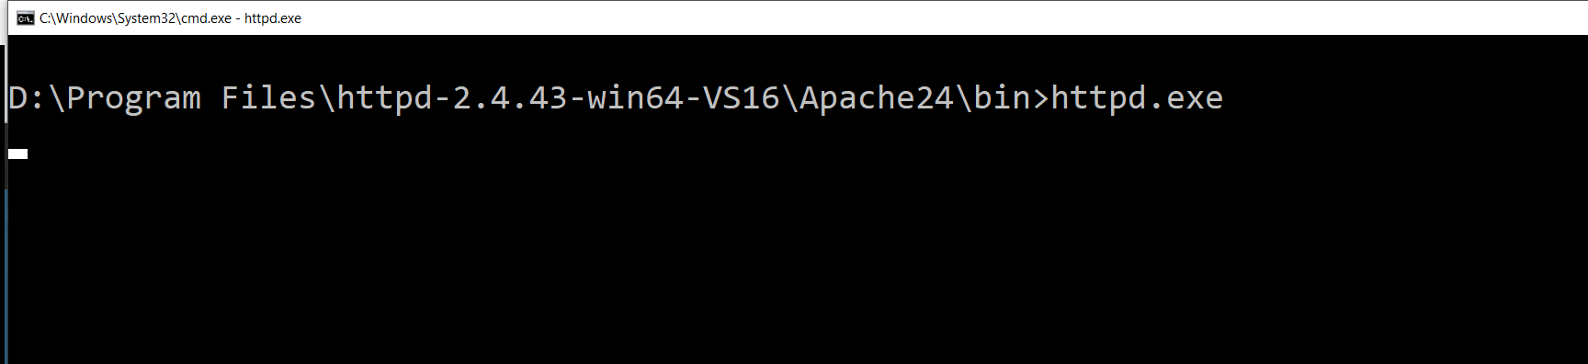
How to install & configure Apache on a Windows server
Step 4 - Start Apache
Open an command/PowerShell prompt in the "bin" folder at the location where you extracted Apache (Hold "Shift" whilst right-clicking and select "Open command window here" or "Open PowerShell window here"):

Slide 64

How to install & configure Apache on a Windows server

Slide 65
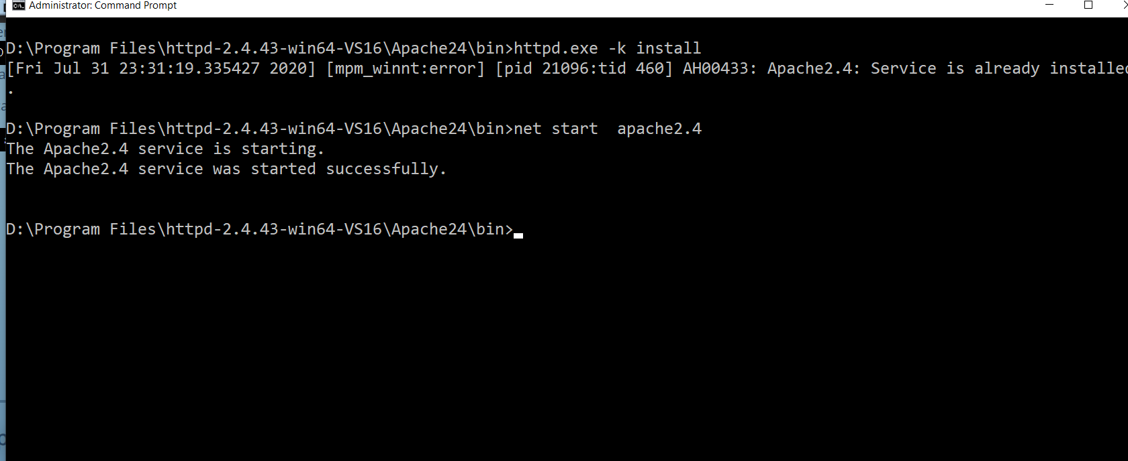
How to install & configure Apache on a Windows server
Step 6: Start as Window Service

Slide 66
How to install & configure Apache on a Windows server
Step 7 - Monitor Apache (optional)
To allow you to monitor the current state of your Apache server, as well as allow you to quickly start/stop/restart the server, Apache comes with a small utility called "Apache Monitor".
Double click ApacheMonitor.exe from the bin folder to run the utility, or place a shortcut to in in your Startup folder so that it automatically runs whenever Windows starts.

Slide 67
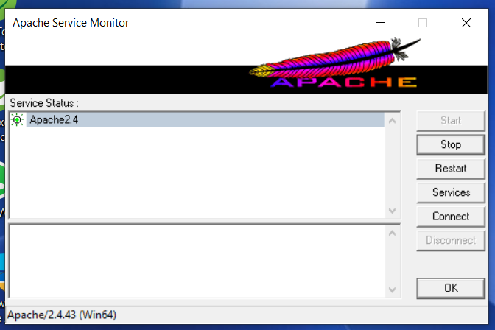
How to install & configure Apache on a Windows server

Slide 68
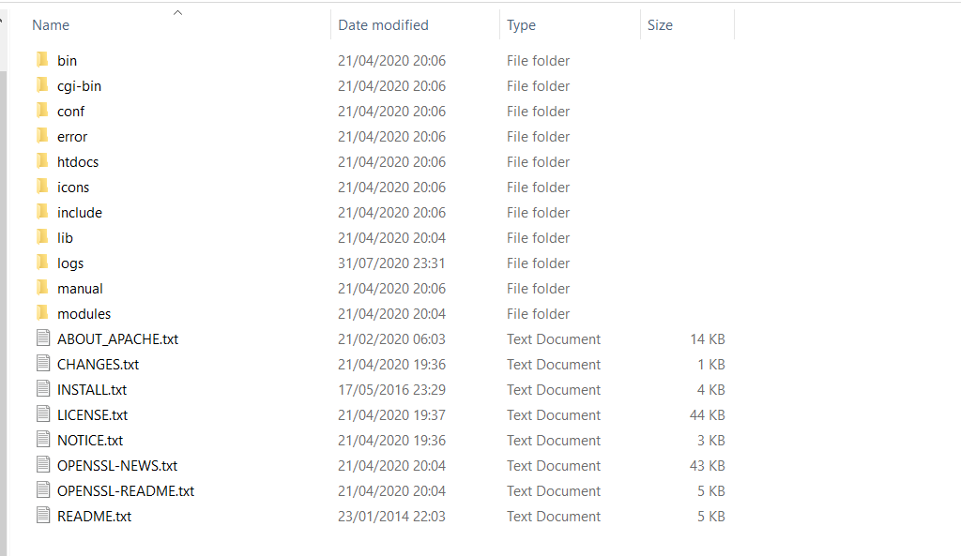
Apache Directory structure

Slide 69
Apache Directory structure
include—Contains all the C header (include) files that are only needed if you develop Web applications that integrate with Apache or want to use use third-party software with Apache, which might require the header files.
On a production server you can remove this directory.

Slide 70
Apache Directory structure
lib — Houses the Apache Portable Run-Time (APR) library files, the files that are required for running Apache, and other support utilities such as ab.
bin—Contains the programs shown in Table .
conf—Houses the configuration files for Apache. It contains the files listed in Table

Slide 71
Apache Directory structure
htdocs—This is the default document root directory for the main Apache server. The httpd.conf file sets the DocumentRoot directive to this directory.
By default the htdocs directory also has the entire Apache manual installed in a subdirectory.
icons—Used to store various Apache icons that are needed for displaying dynamically the build directory listing.

Slide 72
Apache Directory structure
logs—Used to store the Apache server logs, the CGI daemon socket (cgisock), and the PID file (httpd.pid).
cgi-bin—The default CGI script directory, which is set by using the ScriptAlias directive in httpd.conf. By default, Apache comes with two simple CGI scripts—printenv and test-cgi. Each of these scripts prints out CGI environment variables when requested via http://server_name/cgi-bin/script_name URL. These scripts are good for testing whether CGI configuration is working for you.

Slide 73
Apache Directory structure
logs—Used to store the Apache server logs, the CGI daemon socket (cgisock), and the PID file (httpd.pid).
cgi-bin—The default CGI script directory, which is set by using the ScriptAlias directive in httpd.conf. By default, Apache comes with two simple CGI scripts—printenv and test-cgi. Each of these scripts prints out CGI environment variables when requested via http://server_name/cgi-bin/script_name URL. These scripts are good for testing whether CGI configuration is working for you.

Slide 74
Apache Directory structure
It is highly recommend that you remove the printenv and test-cgi scripts after you have your CGI configuration working.
It is not a good idea to have a script that displays your system environment information to anyone in the world.
The less you tell the world about how your system works or about what is available on your system, the more secure your system remains.

Slide 75
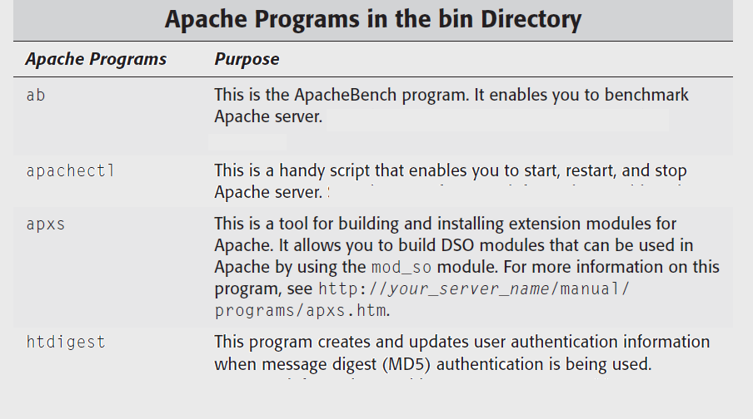
Apache Directory structure

Slide 76
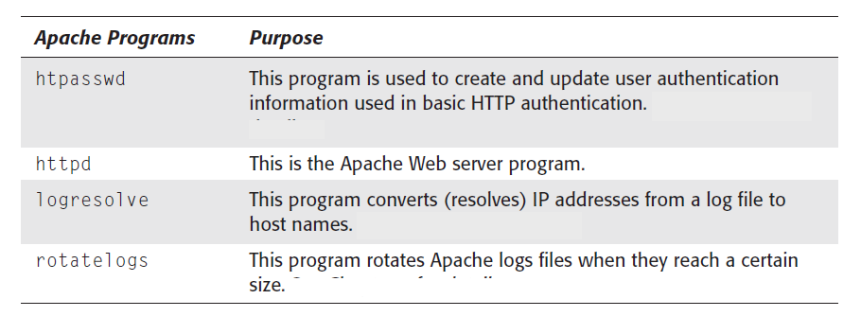
Apache Directory structure

Slide 77
Apache Directory structure

Slide 78
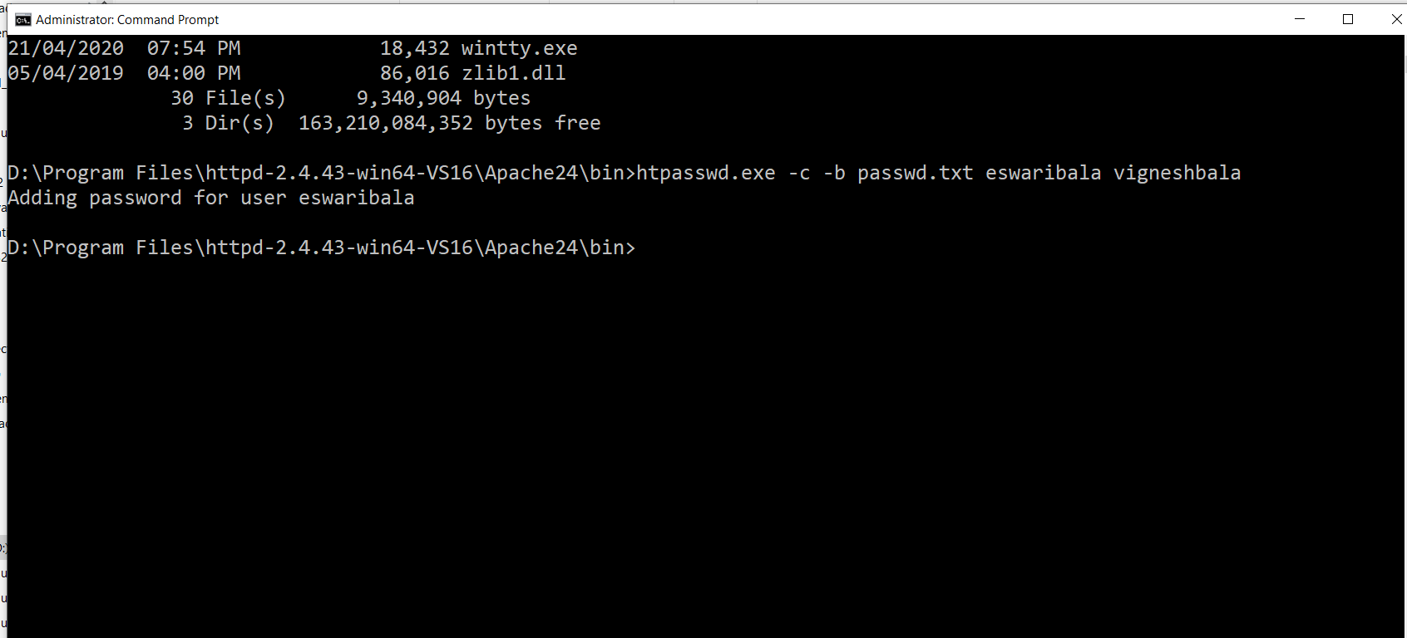
Apache Directory structure

Slide 79
Configuring Apache
By default, Apache reads a single configuration file called httpd.conf.
Every Apache source distribution comes with a set of sample configuration files.
In the standard Apache source distribution, you will find a directory called conf, which contains sample configuration files with the –dist extension.
The very first step you need to take before you modify this file is to create a backup copy of the original.

Slide 80
Configuring Apache
The httpd.conf file has two types of information: comments and server directives.
Lines starting with a leading # character are treated as a comment line; these comments have no purpose for the server software, but they serve as a form of documentation for the server administrator.
You can add as many comments as you want; the server simply ignores all comments when it parses the file.

Slide 81
Configuring Apache
Except for the comments and blank lines, the server treats all other lines as either complete or partial directives.
A directive is like a command for the server. It tells the server to do a certain task in a particular fashion.
While editing the httpd.conf file, you need to make certain decisions regarding how you want the server to behave.

Slide 82
Httpd.conf Segments

Slide 83
Httpd.conf Segments
The left side of the figure shows how the default httpd.conf can be visualized in your mind.
There are configuration directives that create the global server environment that applies to everything; there are configuration options that apply to the main (default) Web site Apache servers, and there are configuration directives that only apply to optional virtual hosts.
Because Apache uses a single configuration file, a site with lots of virtual hosts will have a very large file and management of the configuration becomes very cumbersome.

Slide 84
Configuring the global environment for Apache
The very first directive is ServerRoot, which appears as follows:
ServerRoot “/usr/local/apache”
This directive specifies the top-level directory of the Web server.
The specified directory is not where you keep your Web contents.
It is really a directory, which normally has these subdirectories:

Slide 85
Configuring the global environment for Apache

Slide 86
Configuring the global environment for Apache
/usr/local/apache is the parent directory for all server-related files.
The default value for ServerRoot is set to whatever you choose for --prefix option during source configuration using the configure script.
By default, the make install command executed during server installation copies all the server binaries in %ServerRoot%/bin, server configuration files in %ServerRoot%/conf, and so on

Slide 87
Configuring the global environment for Apache
You should only change the value of this directive if you have manually moved the entire directory from the place on installation to another location.
For example, if you simply run cp -r /usr/local/apache /home/apache and want to configure the Apache server to work from the new location, you will change this directive to ServerRoot /home/apache.
Note that in such a case you will also have to change other direct references to /usr/local/apache to /home/apache.

Slide 88
Configuring the global environment for Apache
Also note that whenever you see a relative directory name in the configuration file, Apache will prefix %ServerRoot% to the path to construct the actual path.

Slide 89
PidFile
The PidFile directive sets the PID (process ID) file path.
By default, it is set to logs/httpd.pid, which translates to %ServerRoot%/logs/httpd.pid (that is, /usr/local/apache/logs/httpd.pid).
Whenever you want to find the PID of the main Apache process that runs as root and spawns child processes, you can run the cat %ServerRoot/logs/httpd.pid command.
Don’t forget to replace %ServerRoot% with an appropriate value.

Slide 90
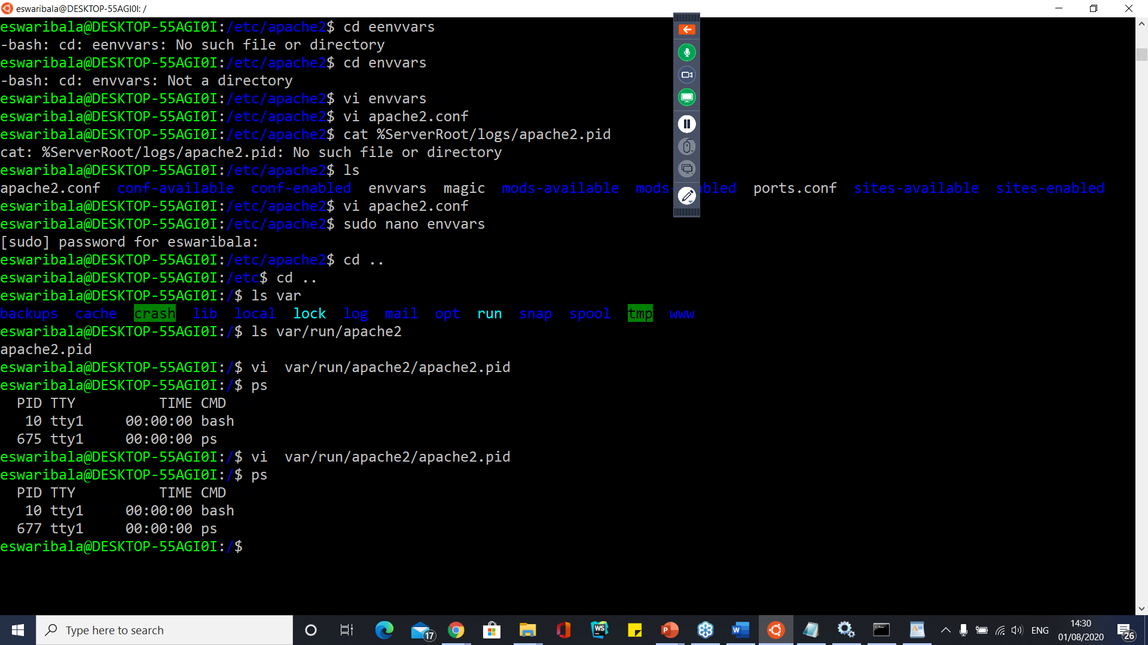

Slide 91
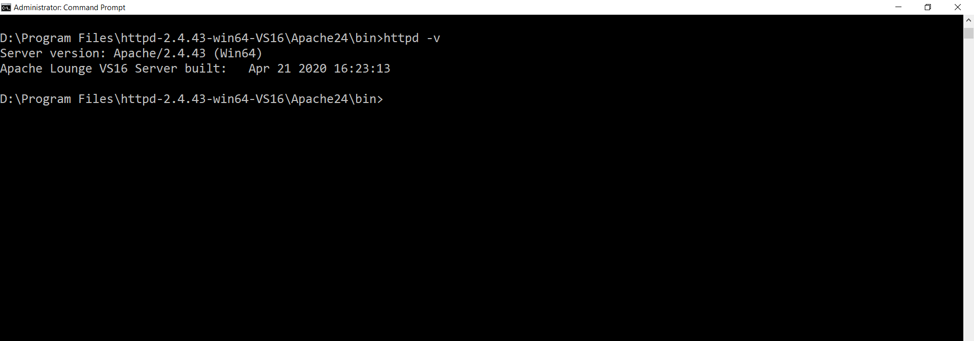
PidFile

Slide 92
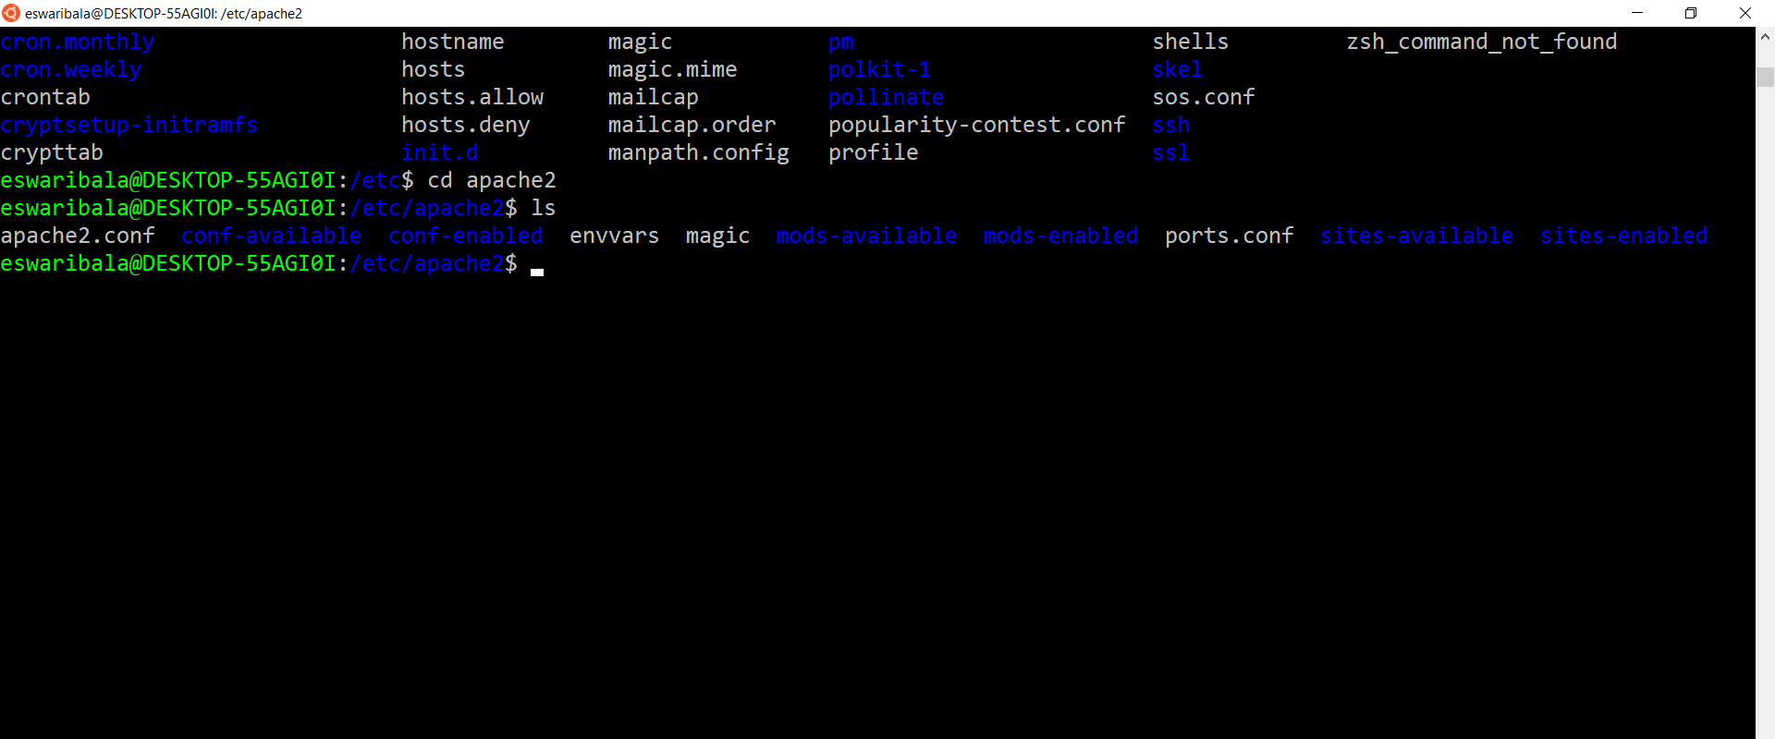
Pid file
D:\Program Files\httpd-2.4.43-win64-VS16\Apache24\logs

Slide 93
ScoreBoardFile
ScoreBoardFile is encapsulated within an if condition by using the
<IfModule . . .> container as shown below:
<IfModule !perchild.c>
ScoreBoardFile logs/apache_runtime_status
</IfModule>
This tells Apache to set the ScoreBoardFile to %ServerRoot%/logs/ apache_runtime_status file only if you have chosen a multiprocessing module (MPM) other than perchild.

Slide 94
ScoreBoardFile
Because the default MPincluding Linux, is threaded instead of perchild, the if condition will be true and Apache will set the ScoreBoardFile directive.
This directive is used to point to a file, which is used to exchange run-time status information between Apache processesM for most operating systems,

Slide 95
Timeout, KeepAlive, MaxKeepAliveRequests, and KeepAliveTimeout
Timeout sets the server timeout in seconds. The default should be left alone.
The next three directives KeepAlive, MaxKeepAliveRequests, and KeepAliveTimeout are used to control the keep-alive behavior of the server.
You do not need to change them.

Slide 96
Timeout, KeepAlive, MaxKeepAliveRequests, and KeepAliveTimeout
IfModule containers Apache will use one of the next three <IfModule . . .> containers based on which MPM you chose.
For example, if you configured Apache using the default MPM mode (threaded) on a Linux system, then the following <IfModule . . .> container will be used:
<IfModule threaded.c>
StartServers 3
MaxClients 8
MinSpareThreads 5
MaxSpareThreads 10
ThreadsPerChild 25
MaxRequestsPerChild 0
</IfModule>

Slide 97
Timeout, KeepAlive, MaxKeepAliveRequests, and KeepAliveTimeout
On the other hand, if you chose --with-mpm=prefork during source configuration by using the configure script, then the following <IfModule . . .> container will be used:
<IfModule prefork.c>
StartServers 5
MinSpareServers 5
MaxSpareServers 10
MaxClients 20
MaxRequestsPerChild 0
</IfModule>
Similarly, the --with-mpm=perchild option forces Apache to use the last <IfModule . . .> container

Slide 98
Directives for threaded (default) MPM behavior
If you did not change the default MPM behavior during source compilation and used the threaded behavior, so the directives that you need to consider are
StartServers
MaxClients
MinSpareThreads
MaxSpareThreads
ThreadsPerChild
MaxRequestPerChild

Slide 99
StartServers
StartServers tells Apache to start three child servers as it starts.
You can start more servers if you want, but Apache is pretty good at increasing number of child processes as needed based on load.
So, changing this directive is not required.

Slide 100
MaxClients
In the default threaded MPM mode, the total number of simultaneous requests that Apache can process is %MaxClients% x %ThreadsPerChild%.
So, because the default for MaxClients is 8 and the default for ThreadsPerChild is 25, the default maximum for simultaneous requests is 200 (that is, 8 times 5).
If you use the preforking MPM mode, the maximum requests is limited to %MaxClients%.
The default maximum of 200 simultaneous requests should work well for most sites, so leave the defaults.

Slide 101
MinSpareThreads
The MinSpareThreads directive specifies the minimum number of idle threads.
These spare threads are used to service requests and new spare threads are created to maintain the minimum spare thread pool size.
You can leave the default settings alone.

Slide 102
MaxSpareThreads
The MaxSpareThreads directive specifies the maximum number of idle threads;leave the default as is.
In the default threaded mode, Apache kills child processes to control minimum and maximum thread count.

Slide 103
ThreadsPerChild
This directive defines how many threads are created per child process.
If you are running Apache on a Windows system, set ThreadsPerChild to the maximum number of simultaneous requests that you want to handle, because on this platform there is only one child process, and it owns all the threads.

Slide 104
MaxRequestPerChild
The final directive for the global environment is MaxRequestPerChild, which sets the number of requests a child process can serve before getting killed.
The default value of zero makes the child process serve requests forever.
I do not like to the default value because it enables Apache processes to slowly consume large amounts of memory when a faulty mod_perl script, or even a faulty third-party Apache module, leaks memory.

Slide 105
MaxRequestPerChild
If you do not plan on running any third-party Apache modules or mod_perl scripts, you can keep the defaults or else set it to a reasonable number.
A setting of 30 ensures that the child process is killed after processing 30 requests.

Slide 106
Configuring the main server
The main server configuration applies to the default Web site Apache serves.
This is the site that will come up when you run Apache and use the server’s IP address or host name on a Web browser.

Slide 107
Port
The very first directive in this section is the Port directive, which sets the TCP port that Apache listens to for connections.
The default value of 80 is the standard HTTP port.
If you change this to another number, such as 8080, you can only access the server using a URL such as http://hostname:8080/.
You must specify the port number in the URL if the server runs on a nonstandard port.

Slide 108
Port
There are many reasons for running Apache on nonstandard ports, but the only good one I can think of is that you do not have permission to run Apache on the standard HTTP.

Slide 109
User and Group directives
The User and Group directives tell Apache the user (UID) and group (GID) names to use.
These two directives are very important for security reasons.
When the primary Web server process launches a child server process to fulfill a request, it changes the child’s UID and GID according to the values set for these directives.
Refer to Figure to see how the primary Web server process that listens for the connection runs as a root user process, and how the child processes run as different user/group processes.
If the child processes are run as root user processes, a potential security hole will be opened for attack by hackers.

Slide 110
User and Group directives
Enabling the capability to interact with a root user process maximizes a potential breach of security in the system; hence, this is not recommended.
Rather, I highly recommend that you choose to run the child server processes as a very low-privileged user belonging to a very low-privileged group.
In most Unix systems, the user named nobody (usually UID = -1) and the group named nogroup (usually GID = -1) are low-privileged.
You should consult your /etc/group and /etc/passwd files to determine these settings.

Slide 111
User and Group directives
If you plan to run the primary Web server as a nonroot (regular) user, it will not be able to change the UID and GID of child processes, because only root user processes can change the UID or GID of other processes.
Therefore, if you run your primary server as the user named ironsheik, then all child processes will have the same privileges as ironsheik.
Similarly, whatever group ID you have will also be the group ID for the child processes.

Slide 112
ServerAdmin
ServerAdmin defines the e-mail address that is shown when the server generates an error page.
Set this to your e-mail address.ServerName.
Now you need to set the host name for the Server using the ServerName directive.
This directive is commented out by default because Apache install cannot guess what host name to use for your system.
So if the host name is called www.domain.com, set ServerName directive accordingly.

Slide 113
DocumentRoot
Like all other Web servers, Apache needs to know the path of the top-level directory where Web pages will be kept.
This directory is typically called the document root directory. Apache provides a directive called DocumentRoot, which can be used to specify the path of the top-level Web directory.
This directive instructs the server to treat the supplied directory as the root directory for all documents. This is a very important decision for you to make.
For example, if the directive is set as:
DocumentRoot / then every file on the system becomes accessible by the Web server

Slide 114
DocumentRoot
You can protect files by providing proper file permission settings, but setting the document root to the physical root directory of your system is definitely a major security risk.
Instead, you should point the document root to a specific subdirectory of your file system.
If you have used the --prefix=/usr/local/apache option in configuring the Apache source, this directive will be set as:
DocumentRoot “/usr/local/apache/htdocs”

Slide 115
Preferred Web Directory Structure

Slide 116
Preferred Web Directory Structure
I chose to create a partition called /www, and under it there are subdirectories for each Web site hosted by my system.
/www/www.mycompany.com/ has three subdirectories:
public, stage, and development.
Each of these subdirectories has two subdirectories: htdocs and cgi-bin.
The htdocs subdirectory is the document root directory, and the cgi-bin subdirectory is used for CGI scripts.
So, the DocumentRoot setting for the www.mycompany.com Web site is:
DocumentRoot “/www/www.mycompany.com/public/htdocs”

Slide 117
Preferred Web Directory Structure
The advantage of this directory structure is that it keeps all Web documents and applications under one partition (/www).
This enables easy backups, and the partition can be mounted on different systems via the Network File System (NFS) in case another machine in the network is given the task to provide Web services.

Slide 118
Directory container directives
The next set of directives are enclosed in a <Directory . . .> container as
shown here:
<Directory />
Options FollowSymLinks
AllowOverride None
</Directory>
The scope of the enclosed directives is limited to the named directory (with any subdirectories); however, you may only use directives that are allowed in a directory context.

Slide 119
Directory container directives
Here the Options and the AllowOverride directives apply to %DocumentRoot% that is root (/) or the top-level directory of the main Web site.
Because directives enclosed within a directory container apply to all the subdirectories below the named directory, the directives apply to all directories within %DocumentRoot%.

Slide 120
Directory container directives
The Options directive is set to FollowSymLinks, which tells Apache to allow itself to traverse any symbolic within %DocumentRoot%.
Because the Options directive is only set to follow symbolic links, no other options are available to any of the directories within %DocumentRoot%.
Effectively, the Options directive is:
Options FollowSymLinks -ExecCGI -Includes -Indexes -MultiViews

Slide 121
Apache Rocks On
Apache runs on Linux and other Unix systems.
Apache also runs on Windows.
Installing Apache
To install Apache, install the latest meta-package apache2 by running:
sudo apt update
sudo apt install apache2
Adjusting Firewall
sudo ufw app list
sudo ufw allow 'apache'

Slide 122
Apache Rocks On
Apache runs on Linux and other Unix systems.
Apache also runs on Windows.
Installing Apache
To install Apache, install the latest meta-package apache2 by running:
sudo apt update
sudo apt install apache2
Adjusting Firewall
sudo ufw app list
sudo ufw allow 'apache'

Slide 123
Apache Rocks On
sudo ufw status
sudo service apache2 start
sudo service --status-all
sudo vi /etc/apache2/ports.conf //to change port number
#to suppress warning when we start server
#add this in ports.conf
AcceptFilter https none
AcceptFilter http none

Slide 124
Apache Rocks On
sudo service apache2 stop
sudo service apache2 restart
sudo service apache2 reload (after config changes)
sudo apachectl -t (test config changes)
sudo apachectl configtest
sudo apache2 –v
Sudo apache2ctl –S (to find errors in conf)

Slide 126
List Important configuration files
$ ls -lh /usr/lib/apache2/modules/ [To List Available Modules]
$ ls -lh /etc/apache2/mods-available/ [To List Available Modules]
$ ls -lh /etc/apache2/mods-enabled/ [To List Enabled Modules]
$ ls -lh /var/www/html [Apache2 Default Web root]
$ ls -lh /var/www/ [Other Website Web root]
$ less /etc/apache2/apache2.conf [Apache2 Main Configuration File]
$ less /etc/apache2/ports.conf [Apache2 Ports Configuration File]
$ less /var/log/apache2/error.log [Apache2 Error Log File]
$ less /var/log/apache2/access.log [Apache2 Access Log File]

Slide 127
Modify Default Sites
$ sudo mkdir -p /var/www/test.com
$ cd /var/www/test.com
$ sudo nano index.html
<head>
<title>Test.com index page</title>
</head>
<h1>Hello, welcome to test.com! It works!</h1>
<h2>That is all I have to say. If you don't see this then it doesn't work.</h2>
</body>
</html>

Slide 128
Modify Default Sites
$ cd /etc/apache2/sites-available/
$ sudo nano test.com.conf
<VirtualHost *:80>
ServerAdmin carla@localhost
DocumentRoot /var/www/test.com
ServerName test.com
ServerAlias www.test.com
ErrorLog ${APACHE_LOG_DIR}/error.log
CustomLog ${APACHE_LOG_DIR}/access.log combined
</VirtualHost>

Slide 129
Modify Default Sites
$ sudo a2ensite test.com.conf
Enabling site test.com.
To activate the new configuration, you need to run:
service apache2 reload

Slide 130
Questions

Slide 131
Module Summary
Web Server Administration
Apache virtual host workflow and configuration in detail
Apache MPM configurations and usages
Server capacity (like RAM, ROM) needed for n number of users (say n=3000+).
Apache tuning when there is high server load
Other Apache mechanism for handling uncertain situations

